Slide 1
CAPSTONE PROJECT
Kenneth Chew
General Assembly- Data Science Immersive 8

Slide 2
Contents
Dataset
Modelling with CNN
image augmentations/pre-processing
Modelling with DCGANs
Loss terms implementation
Future recommendations
References

Slide 3
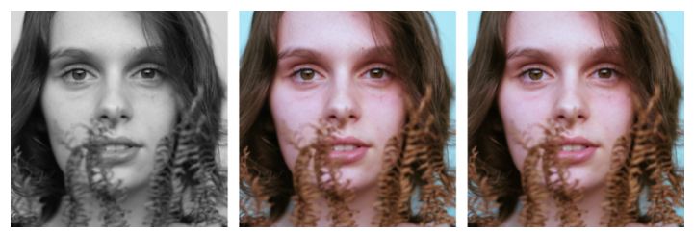
CAPSTONE IDEA
Problem statement
To colorise non-colored pictures and bring new perspective to old pictures with color.
Goals
To create a deep learning model using transfer learning from existing CNN models to learn how pictures are colored and reverse engineer onto greyscale pictures
Gives images more personality/character
Easier to notice things of contrasting colors

Slide 4
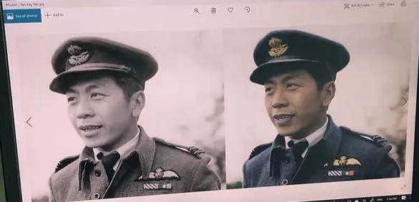
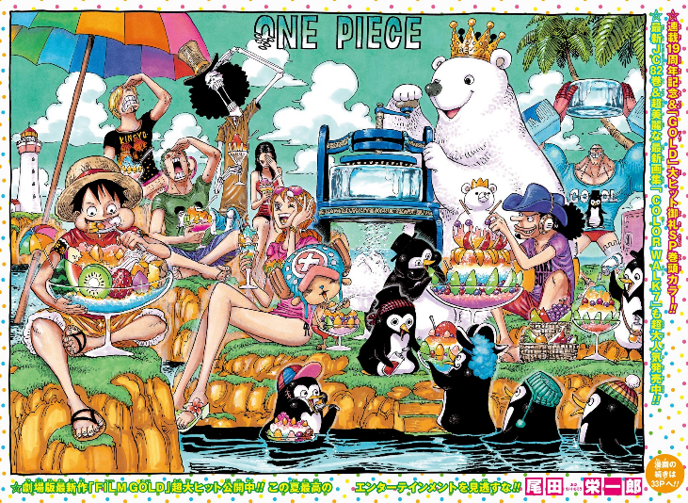
Potential Audience
The art community
Old National Gallery records/paintings/pictures
National Heritage Board
National Museums
Comic community
B/W comics to color

Slide 5
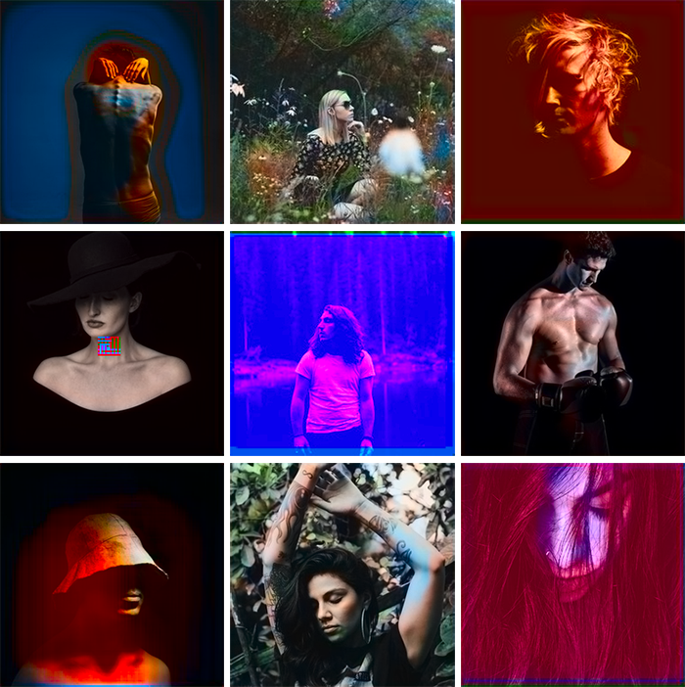
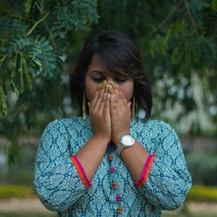
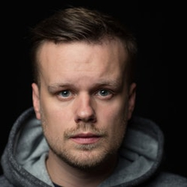
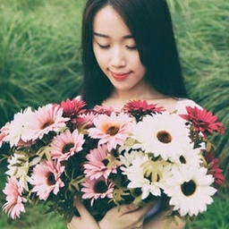
dataset
Data Sources
Unsplash (10,000 pictures);
(emil wallner, 2017)

Slide 6
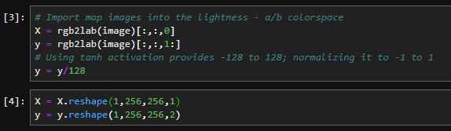
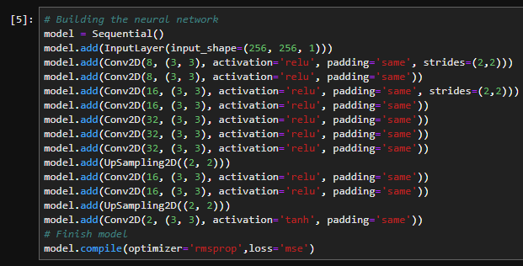
Start of experiment 1
Using Keras with Tensorflow backend
Simple convolutional and deconvolutional layers

Slide 7
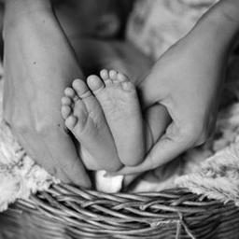
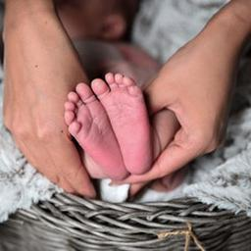
Result of validation of same input
Looks good!
Notes:
The generator output is AB color space 2ndim picture, concatenated with original L input on axis 3 and output as image

Slide 8
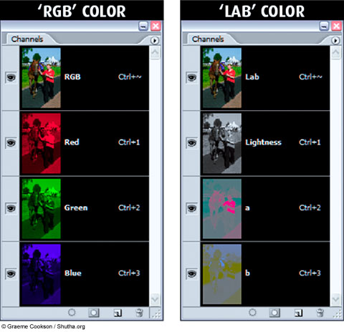
Learning outcomes
Images input can be done with various types
np.array
Activation layer on the output layer and ground truth range must coincide
[-1 to 1] after dividing by 128
Lightness/ A-B colour space can help capture the details of grey colour better since L color scale holds more acuity than colored spaced a & b
Notes:
Range of LAB [(0-100),(-128,128),(-128,128)]

Slide 9
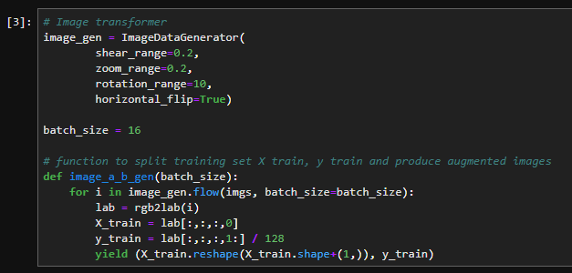
Experiment 2
Image Augmentation to further increase sample size
.fit_generator instead of .fit
Increase the number of steps so that more image augmentation is used for the training

Slide 10
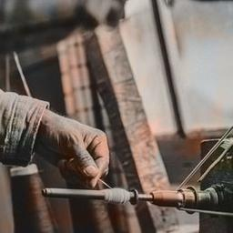
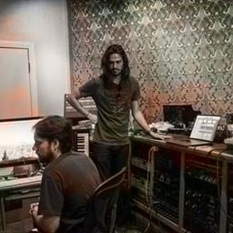
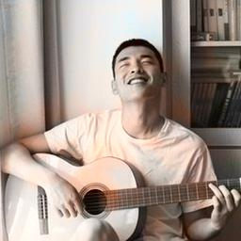

Results of experiment 2
Too brown? And colours are in patches and not evenly spread

Slide 11
Learning outcomes
Neural Architecture insufficient to segment the subject of the image with its backgrounds.
Number of neurons per layer
Number of layers
Loss term causing the outcome to choose brown as the closest colour with lowest loss.

Slide 12
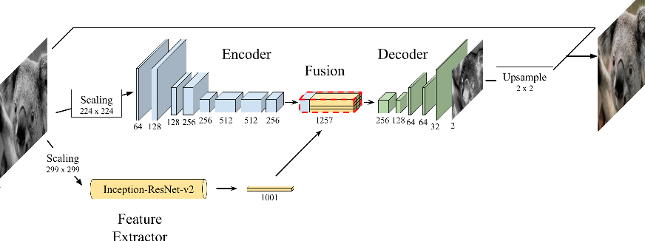
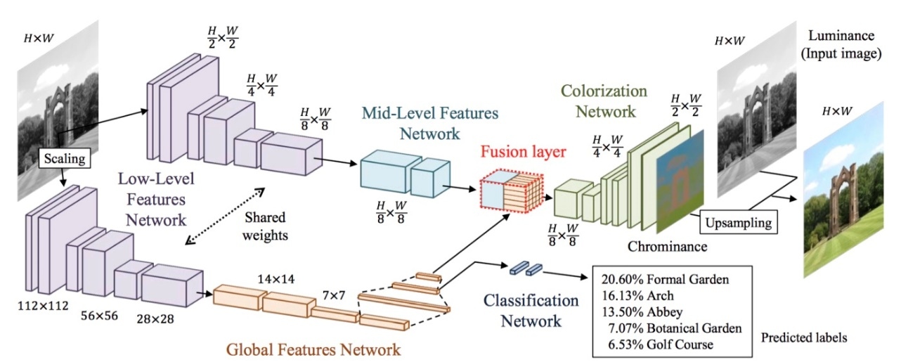
Back to literature review again FOR NEURAL ARCHITECTURE SEARCH
(Baldassarre, Morin & Rodes-Guirao, 2017)
(Iizuka, Simo-Serra & Ishikawa, 2017)

Slide 13
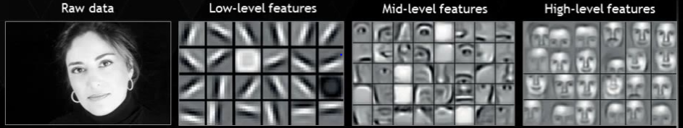
Experiment 3
Need to capture both low level features as well as high level features when convoluting
High level features can be captured using transfer learning from pre-trained models
Mobilenet
InceptionResNet
YOLO
Notes:
Why high and low? Well low features tells us the boundaries of the segmentation to when colour changes from one colour to the other. High level features hopefully will properly help segment out the colouring area the model is supposed to color.
Although you see the person as a whole, there are discerning portions where colours should differ.

Slide 14
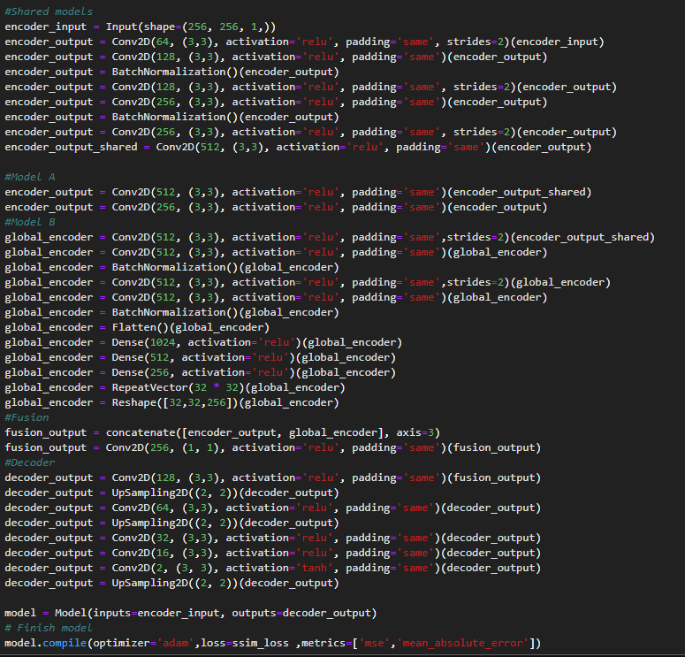
My version
Trial without using a pre-establish model for transfer learning
Transfer learning version using Inception ResNet V2

Slide 15
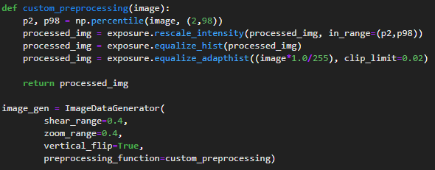
A little more pre-processings
Scikit Learn Exposure pre-processing method:
Rescale contrast
Histogram equalization
Adaptive equalization
For the neural architecture:
Batch normalization so that gradient descent is faster
Dropout layers to make more robust learning

Slide 16
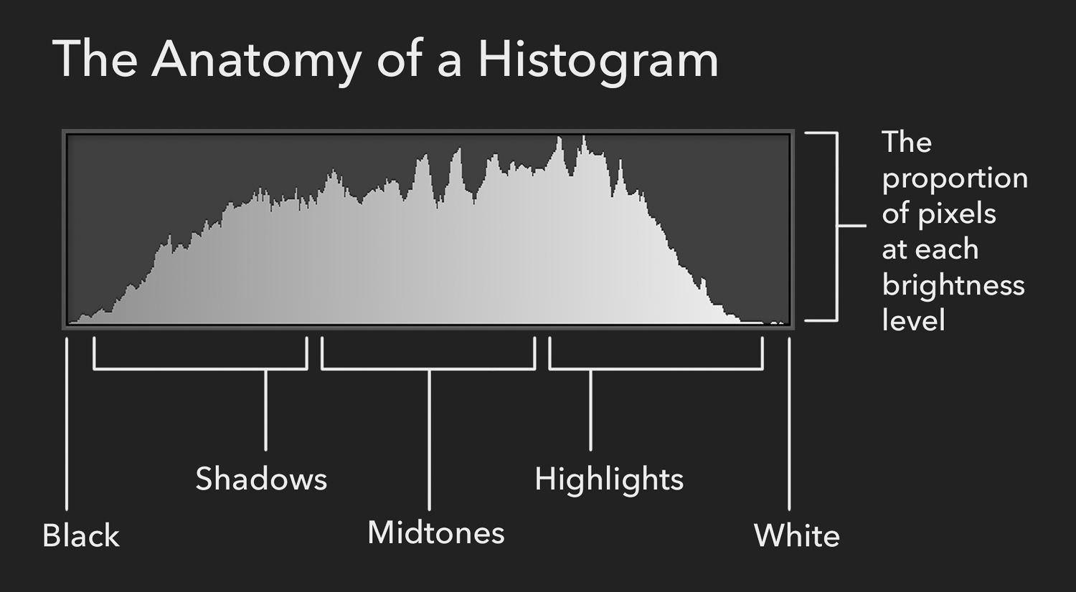

Slide 17
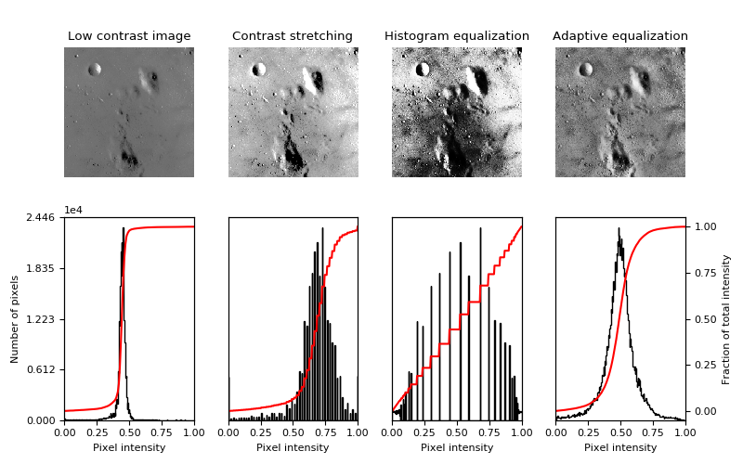
Histogram equalization

Slide 18
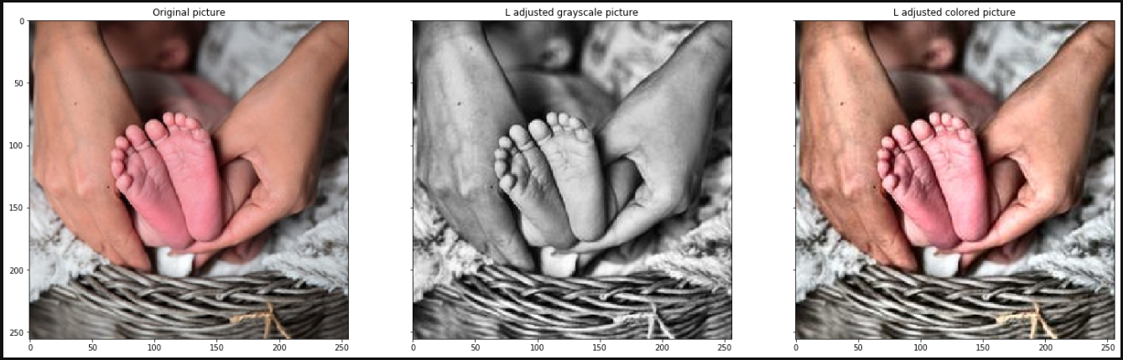
Visualising the change

Slide 19
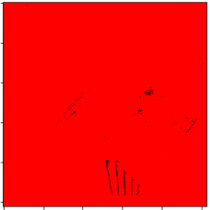
Results of experiment 3
????

Slide 20
Hindsight
Mistakes made:
Input image was pixels numbers were everywhere;
[0,1] when converting to LAB colour space
[0,255] with scikit image library package
Final output had to be in [-1,1]
Experimental neural architecture not something that can be change simply on a whim
Retried with Inception ResNetV2, but output was still not spectacular.

Slide 21
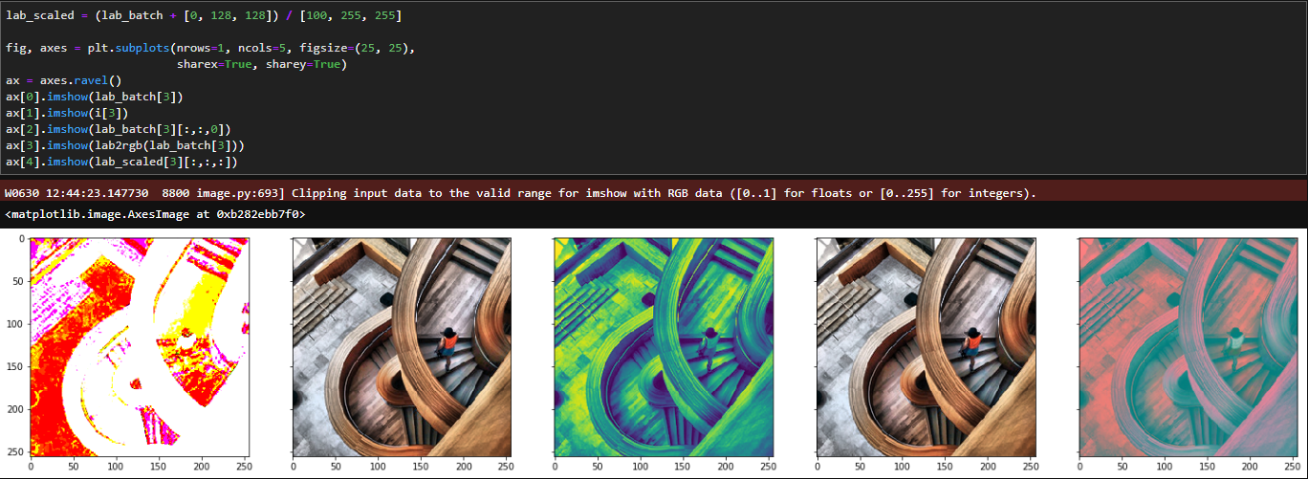
Normalization properly

Slide 22
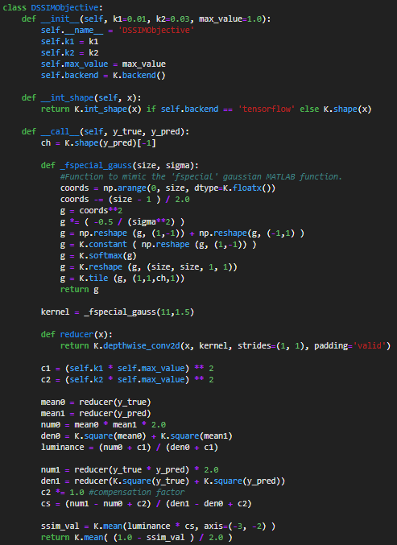
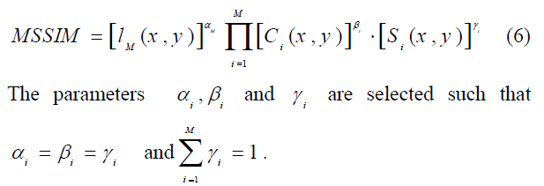
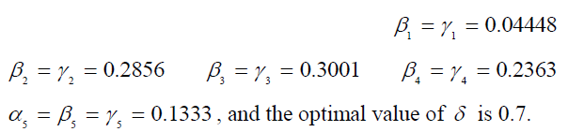
Experiment 4
New loss term with SSIM
Measures the similarity index between ground truth and output image

Slide 23
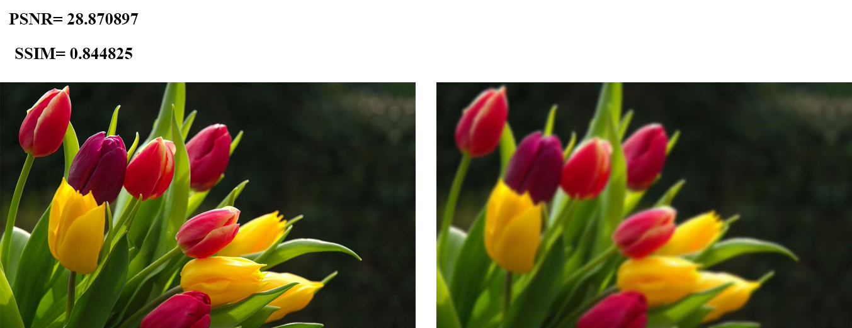
Structural similarity

Slide 24
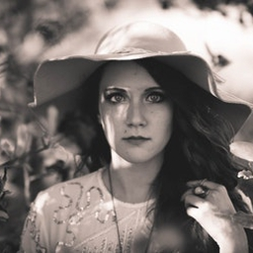
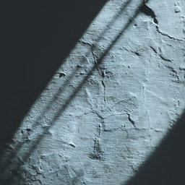
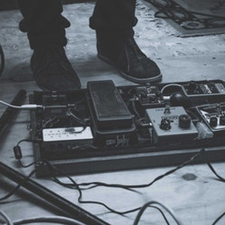
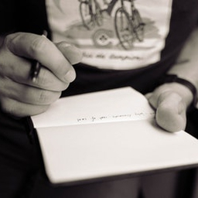
Unfortunately not successful

Slide 25
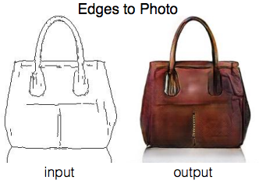
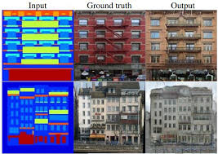
Revisit the problem statement -dcgans
New algorithm for deep learning
pix2pix (affinelayer)
Using Generative Adversarial Networks to produce images
Amazing because it can use noise for input!
(Isola, Zhu, Zhou & Efros, 2017)

Slide 26
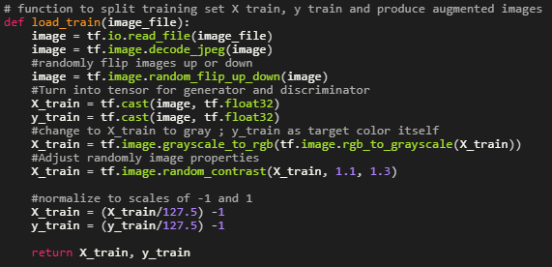
Revisit the problem statement
Not too many image augmentation, just flipping randomly
Instead of using UpSampling
Change to Conv2DTranspose

Slide 27
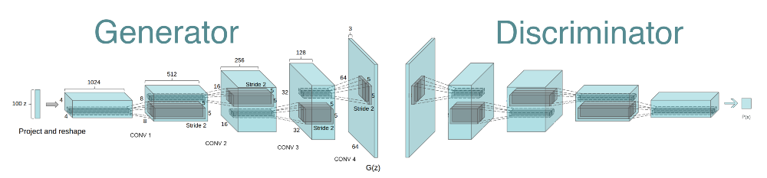
Generative adversarial network
Notes:
Not start of from noise, but start from gray and becomes colour

Slide 28
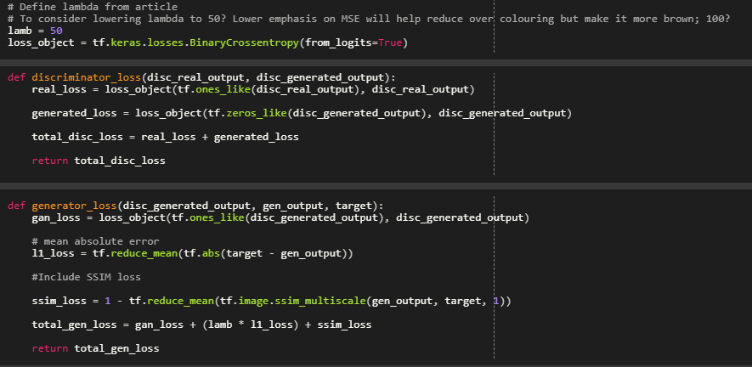
Loss functions for g and d
Discriminator loss to include binary cross entropy from [1 & ground truth] and [0 vs generated]
Generator loss to include MSE, binary cross entropy & SSIM

Slide 29
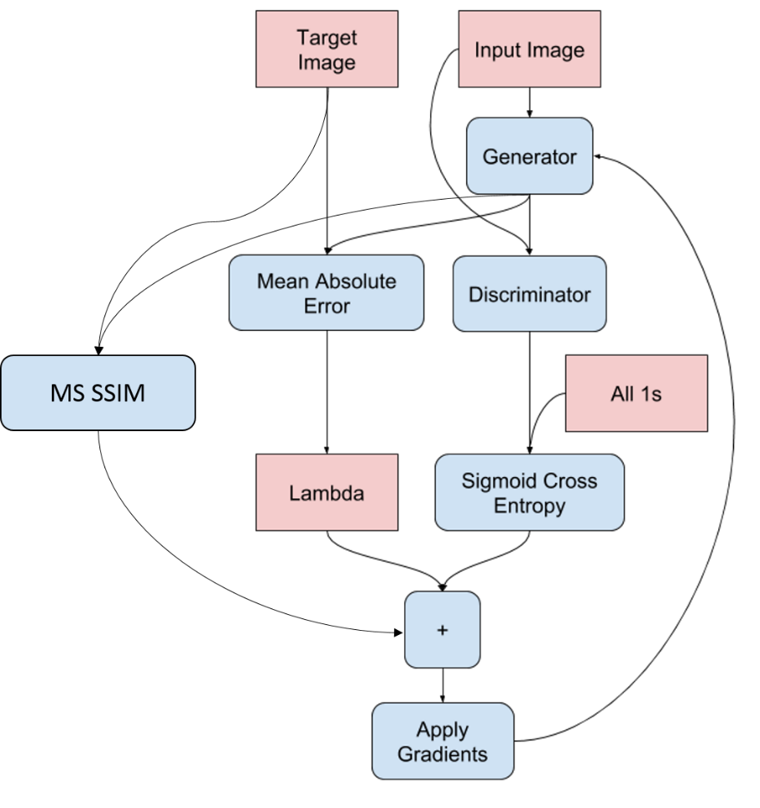
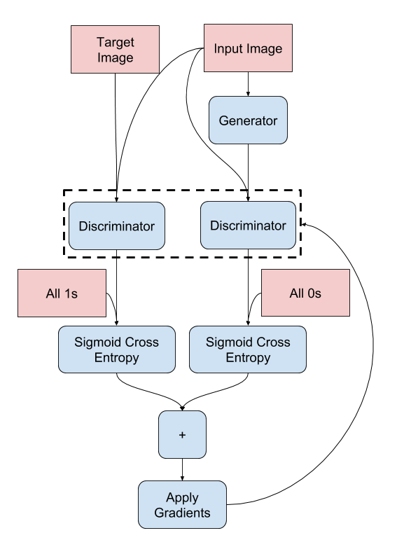

Slide 30
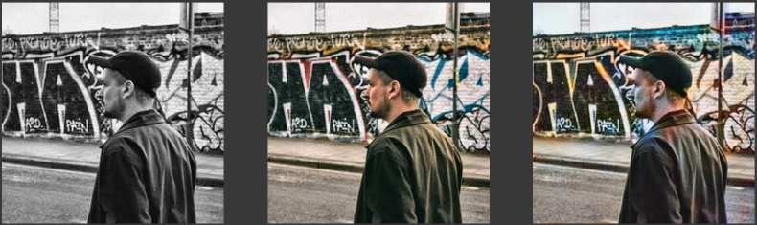
results
Input Ground Truth Prediction

Slide 31
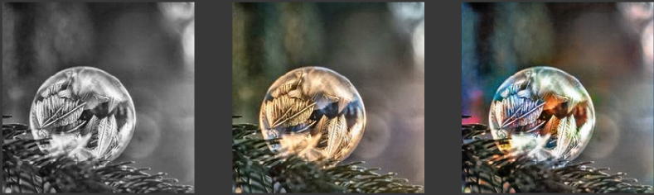
results
Input Ground Truth Prediction

Slide 32
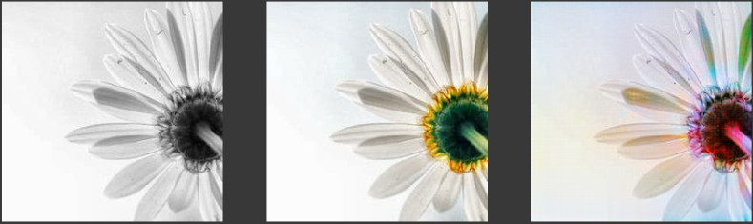
results
Input Ground Truth Prediction

Slide 33
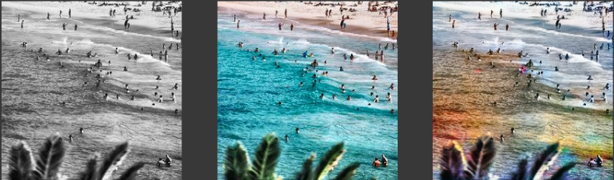
results
Input Ground Truth Prediction

Slide 34
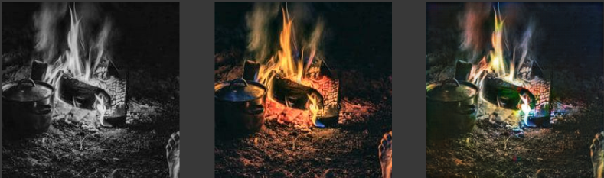
results
Input Ground Truth Prediction

Slide 35
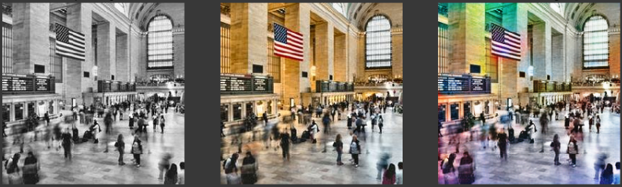
results
Input Ground Truth Prediction

Slide 36
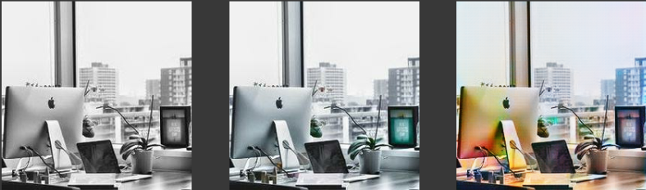
results
Input Ground Truth Prediction

Slide 37
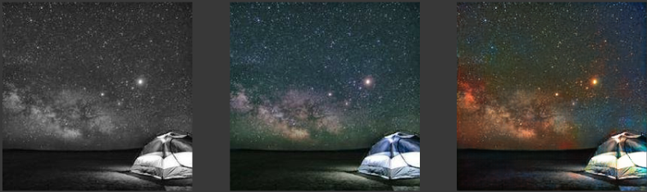
results
Input Ground Truth Prediction

Slide 38
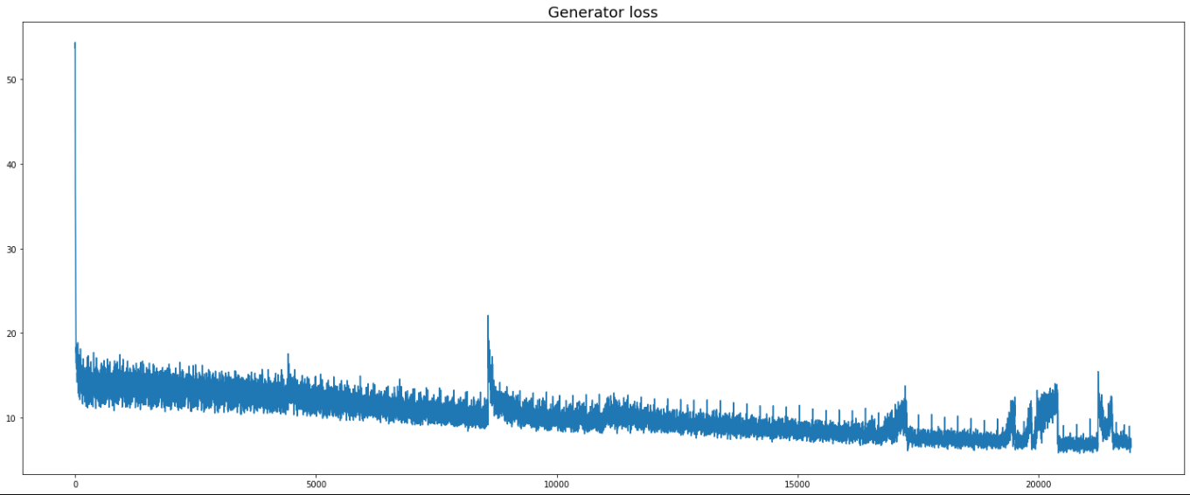
Graph for g and d loss terms

Slide 39


Slide 40
Learning outcome
Different algorithms can work for the same problem
CNN
DCGANs
Many parameters can be changed to optimize the problem
Loss terms
Pre-processing of inputs
Time management, especially for large epoch numbers
Notes:
Histogram/Inputs as gray or change to LAB/YUV color space

Slide 41



deployment in flask
https://127.0.0.1:5000

Slide 42
Future recommendations
Use different dataset of images
Apply technique to videos
Apply neural architecture search to look for optimal NN for coloring grayscale pictures
Use 3 different models each to predict the levels of R,G and B from grayscale and combine the outputs together (Suárez, Sappa, & Vintimilla, 2017 – Triplet DCGANs)

Slide 43
References
Baldassarre, F., Morín, D. G., & Rodés-Guirao, L. (2017). Deep koalarization: Image colorization using cnns and inception-resnet-v2. arXiv preprint arXiv:1712.03400.
Iizuka, S., Simo-Serra, E., & Ishikawa, H. (2017). Globally and locally consistent image completion. ACM Transactions on Graphics (ToG), 36(4), 107.
Isola, P., Zhu, J. Y., Zhou, T., & Efros, A. A. (2017). Image-to-image translation with conditional adversarial networks. In Proceedings of the IEEE conference on computer vision and pattern recognition (pp. 1125-1134).
Sim, Fann (2018, December 30). Bringing Singapore's history to life with a splash of colour. Retrieved from https://www.channelnewsasia.com/news/singapore/singapore-digital-colourist-black-white-historical-photos-11065906

Slide 44
References
Suárez, P. L., Sappa, A. D., & Vintimilla, B. X. (2017). Infrared image colorization based on a triplet dcgan architecture. In Proceedings of the IEEE Conference on Computer Vision and Pattern Recognition Workshops (pp. 18-23).
Wallner, Emil (2017, October 29). How to colorize black & white photos with just 100 lines of neural network code. Retrieved from https://medium.com/@emilwallner/colorize-b-w-photos-with-a-100-line-neural-network-53d9b4449f8d

Slide 45



